Slide 2

Subject: Project II
Abstractive Long Text Summarization
Student: Vu Lam Anh - 20214876
Supervisor: Associate Prof Nguyen Thi Kim Anh
Class Code: 738755

Slide 3
Outline
Introduction
Dataset
Approach
Experiment and Result
Conclusion
Future Work
References

Slide 4
Outline
Introduction
Dataset
Approach
Experiment and Result
Conclusion
Future Work
References

Slide 5
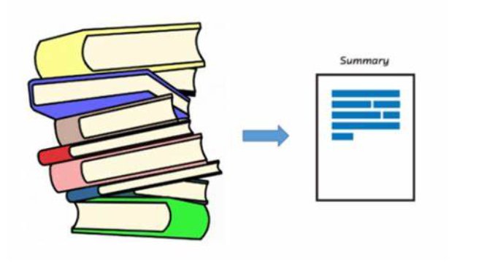
Introduction
Text summarization is one of the main tasks in Natural Language Processing and has been applied in many areas.
Objectives: Producing the shorter version of a long text or document while preserving the key information and meaning from the original document.
In an age of abundant information, summarizing lengthy texts efficiently is essential. But traditional extractive summarization methods, often fail to capture the full essence and overarching themes of complex document
Long abstractive text summarization
Ex: Summarize the book with concise summary
In this project, we want to consider various approaches that can deal efficiently with long abstractive summarization.

Slide 6
Outline
Introduction
Dataset
Approach
Experiment and Result
Conclusion
Future Work
References

Slide 7

Dataset
In this report, we use the PubMed dataset originated from paper “A Discourse-Aware Attention Model for Abstractive Summarization of Long Documents”
It consists of long documents of length ranging from several thousands of words to over ten thousands words.
Each document in PubMed is a scientific article, collected from PubMed.com, and the reference summary is the associated abstract.
Citations in PubMed primarily stem from the bio-medicine and health fields, and related disciplines such as life sciences, behavioral sciences, chemical sciences, and bio-engineering.

Slide 8
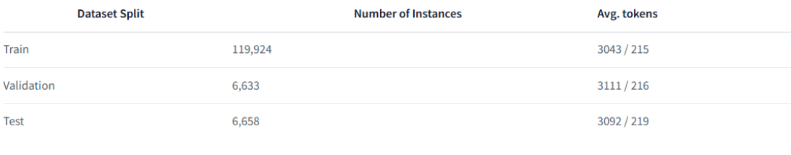
Dataset
Some statistic information of PubMed dataset:
With the average tokens higher than 3000 tokens, PubMed document is considered ”Long document” and also abstractive since it use the abstract part as the summary

Slide 9
Outline
Introduction
Dataset
Approach
Experiment and Result
Conclusion
Future Work
References

Slide 10
Approach
Overview
In general, to deal with the long text summarization with transformer-based model, there are three common ways:
End-to-End model with efficient attention
Retrieve-then-summarize
Divide-And-Conquer
In this report, we focus on the two approaches: End-to-End model with efficient attention and Retrieve-then-summarize while leaving the third ones for exploring in the future.

Slide 11
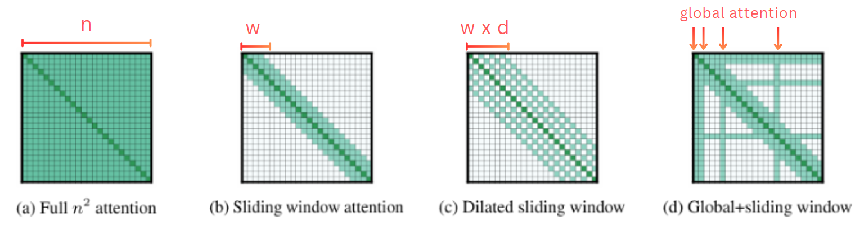
Approach: End-to-End model with efficient attention
Efficient Attention
There are three options to design for attention pattern: Sliding window, Dilated Sliding Window, Global Attention
Src: Iz Beltagy, Matthew E. Peters, Arman Cohan (2020) : Longformer: The Long-Document Transformer

Slide 12
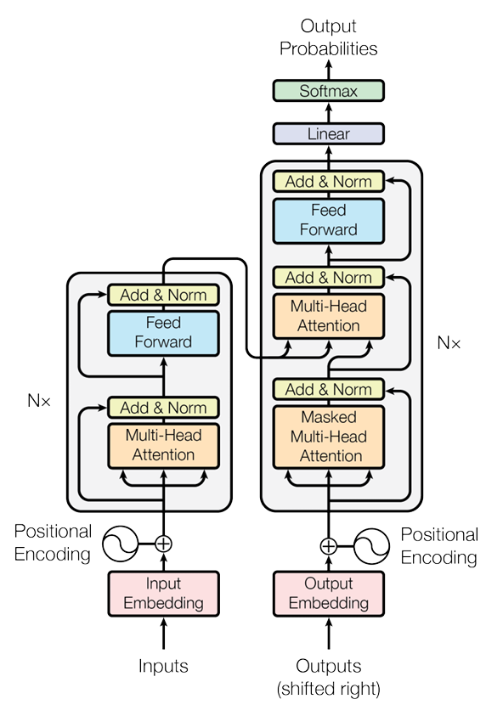
Approach: End-to-End model with efficient attention
Longformer Encoder Decoder
Effectively applies the efficient attention into the encoder-decoder Transformer models that will help us to cope with the long text better.
LED uses the efficient local+global attention pattern with window size is 1024 tokens and the global attention on the first < s > token in the Longformer encoder.
The decoder uses the full self-attention.
To process longer inputs, LED extend position embedding to 16K tokens by repeatedly copying BART’s 1K position embeddings 16 times
Transformer Architecture. Source:[1706.03762] Attention Is All You Need (arxiv.org)

Slide 13
Approach: Retrieve-then-summarize
Overview
There are two general approach to the content selection are:
Ground-truth based (ORCALE)
Model-based
Each approach has its own weaknes:
Oracle method: not feasible in the testing time.
Model-based: hard for training time.
We will address the problems by combining them together.

Slide 14
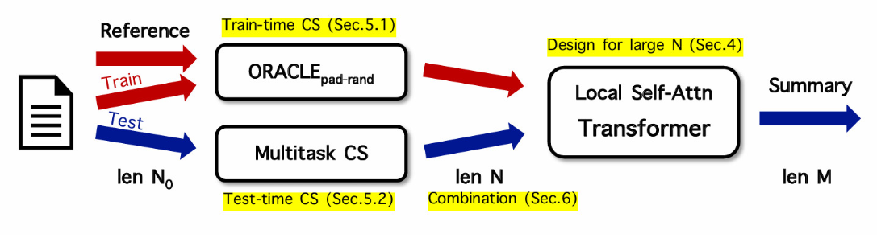
Approach: Retrieve-then-summarize
Overview
Here is the whole process:
Source: Potsawee Manakul and Mark Gales. 2021. Long-Span Summarization via Local Attention and Content Selection. In Proceedings of the 59th Annual Meeting of the Association for Computational Linguistics and the 11th International Joint Conference on Natural Language Processing (Volume 1: Long Papers), pages 6026–6041, Online. Association for Computational Linguistics.
In the next, we will discuss details about each component.

Slide 15
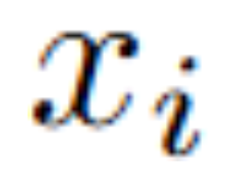

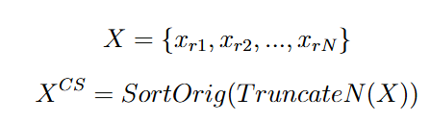
Approach: Retrieve-then-summarize
Oracle
We call each sentence in the document is and we compute the ranking score of each sentence based on the similarity measure d with the reference summary y:
In this report we choose d is the ROUGE-2 recall
After computing the ranking score, we can re-rank the sentence with maintaining the original sentence order as follow:

Slide 16
Approach: Retrieve-then-summarize
Oracle
However, the no-padding oracle method above is highly aggressive, potentially preventing the downstream summarizer from learning complex abstraction.
Therefore, there are proposed variant of oracle method is ORC-pad-rand. With ORC-pad-rand, instead of compute ranking score with only the sentence individually, it pad by random unselected sentences and keep the original sentence order then compute the score.

Slide 17
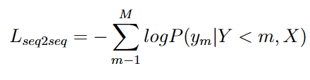
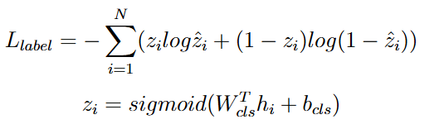

Approach: Retrieve-then-summarize
Multitask Content Selection
Training Stage
First, the model is trained on seq2seq RNN hierarchical abstractive summarization objective with loss function as follow:
Second, we create binary labels as follows: for sentence i, the label zi is 1 if d(xi, y) > 0; else zi is 0, and d is the ROUGE-2 recall measure. The extractive labelling task objective is:
The MCS training loss is as follow:

Slide 18
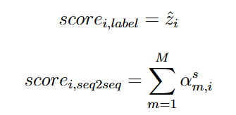
Approach: Retrieve-then-summarize
Multitask Content Selection
Inference Stage
For sentence i, the scores are computed as follow:
The MCS inference score is:
Based on that MCS score, we can rank the most important content and select from the highest to lowest score until we reach the maximum length.

Slide 19
Outline
Introduction
Dataset
Approach
Experiment and Result
Conclusion
Future Work
References

Slide 20
Experiment & Result
Data Preprocessing
Load the Pubmed dataset section from the armanc/scientific papers Huggingface hub
Filter out all the document which have the number of tokens that are lower than 4096 tokens and only keep those has higher than that. Therefore, it will notify the effectiveness of the content selection method.
Due to the limitation of computing resources, we only use 20000 samples for training and about 1500 samples for validating and testing.

Slide 21
Experiment & Result
BART experiments
We use the original BART model as baseline so we can show clearly the effectiveness of LED over BART and BART with content selection compared to BART with only truncation.
The number paramerters of model : 406 M
We will fine-tuned BART model in two versions: No Content Selection (Truncation) and with Content Selection
For simplicity, we will fine-tune the pre-trained model from facebook/bart-large-cnn HuggingFace hub.

Slide 22
Experiment & Result
LED experiments
We utilize the pre-trained LED model by loading the model from pszemraj/led-base-book-summary Hugging face hub. This pre-trained model is the fine-tuned version of original LED-base model on the booksum dataset.
The number paramerters of model : 162 M
We fine-tune two version for LED model : One is the model with maximum number tokens of input is 4096 tokens and other is 8192 tokens

Slide 23
Experiment & Result
LED experiments
Belows are the hyperparameter settings for fine-tuning model:
learning_rate: 5e-05
train_batch_size: 2
eval_batch_size: 2
seed: 42
gradient_accumulation_steps: 8
total_train_batch_size: 16
optimizer: Adam with betas=(0.9,0.999) and epsilon=1e08
lr_scheduler_type: linear
lr_scheduler_warmup_steps: 700
num_epochs: 2
label_smoothing_factor: 0.1

Slide 24
Experiment & Result
Content Selection experiments
In the training stage, we use the ORC_pad_rand method with the similarity measure: ROUGE-2 recall to select the most important sentences until total tokens exceeds 4096 tokens for LED and 1024 tokens for BART.
During the above training, we also train the hierarchical encoder decoder with attention mechanism with based on the abstractive summary and a classification layer based on the extracted document which are chosen by the ORC_pad_rand method.

Slide 25
Experiment & Result
Content Selection experiments
The hyperparameter settings for the training hierarchical model below:
embedding_dim: 256
rnn_hidden_size: 512
num_layers_enc : 2
num_layers_dec : 1
learning_rate: 0.001
train_batch_size: 2
eval_batch_size: 2
optimizer: Adam with betas=(0.9,0.999) and epsilon=1e-08
lr_scheduler_type: linear
lr_scheduler_warmup_steps: 1500
num_epochs: 2
dropout : 0.1

Slide 26
Experiment & Result
Content Selection experiments
In the inference stage, we use the hierarchical model above to compute the MCS score and based on that we can rank and select the most important sentences until achieving the maximum length : 4096 tokens for LED and 1024 tokens for BART.

Slide 27
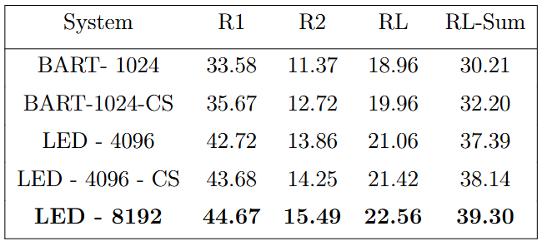
Experiment & Result
Result
Below show the results:

Slide 28
Outline
Introduction
Dataset
Approach
Experiment and Result
Conclusion
Future Work
References

Slide 29
Conclusion
Our experimental results demonstrate that effectiveness of model with efficient attention over the original BART model in dealing with long document.
The content selection also show its advantage when the model with content selection perform better than ones without content selection
In overall the best model is LED with number of input tokens is 8192 tokens, it shows that the content of document in this dataset are distributed over the whole text, not in some specific parts.
The content selection in this case will not maximize its efficiency, while increasing the number input tokens with efficient attention for capturing much information is more appropriate.

Slide 30
Outline
Introduction
Dataset
Approach
Experiment and Result
Conclusion
Future Work
References

Slide 31
Future Work
Explore the Divide-and-conquer method.
Incorporating structural information.
Text post-processing such as correcting grammar, eliminating redundancies,...

Slide 32
Outline
Introduction
Dataset
Approach
Evaluation
Experiment and Result
Future Work
References

Slide 33
References
[1] Ashish Vaswani, Noam Shazeer, Niki Parmar, Jakob Uszkoreit, Llion Jones, Aidan N. Gomez, Lukasz Kaiser, Illia Polosukhin(2017) : Attention is All You Need (https://arxiv.org/abs/1706.03762)
[2] Iz Beltagy, Matthew E. Peters, Arman Cohan(2020): Longformer: The Long-Document Transformer (https://arxiv.org/abs/2004.05150)
[3] Mike Lewis, Yinhan Liu, Naman Goyal, Marjan Ghazvininejad, Abdelrahman Mohamed, Omer Levy, Ves Stoyanov, Luke Zettlemoyer(2019): BART: Denoising Sequence-to-Sequence Pre-training for Natural Language Generation, Translation, and Comprehension (https://arxiv.org/abs/1910.13461)
[4] Potsawee Manakul, Mark J. F. Gales(2021): Long-Span Summarization via Local Attention and Content Selection (https://arxiv.org/abs/2105.03801)
[6] PubMed dataset: armanc_scientific_papers (https://huggingface.co/datasets/armanc/scientific_papers)
[7] Arman Cohan, Franck Dernoncourt, Doo Soon Kim, Trung Bui, Seokhwan Kim, Walter Chang, Nazli Goharian(2018): A Discourse-Aware Attention Model for Abstractive Summarization of Long Documents (https://arxiv.org/abs/1804.05685)

Slide 34
THANK YOU !

